Slide 1
E-CoMmerCe Website Logs
CAPSTONE PROJECT
Presented By:
Shreyansh Kumar Jha Kalinga Institute of Industrial Technology, Bhubaneswar Information Technology

Slide 2
OUTLINE
Problem Statement
Proposed System/Solution
System Development Approach
Result
Conclusion
Future Scope
References

Slide 3
Problem Statement
E-commerce website logs data created for helping the data analysts to practice exploratory data analysis and data visualization. The dataset has data on when the website was accessed, IP address of the source, Country, language in which website was accessed, amount of sales made by that IP address.

Slide 4
Proposed Solution
Data Collection:
- Log data on access timestamps, IPs, countries, languages, and sales.
- Ensure data integrity and accuracy.
Data Preprocessing:
- Clean and normalize the dataset.
- Handle missing values and outliers.
- Convert timestamps to standard formats.
Exploratory Data Analysis (EDA):
- Traffic Analysis: Access patterns by time and region.
- Sales Analysis: Correlate IPs with sales amounts.
- Language Preferences: Language distribution among users.

Slide 5
Proposed Solution (cont.)
Data Visualization:
- Time Series Plots: Traffic and sales trends.
- Geographical Maps: User distribution and sales by country.
- Bar Charts: Sales and access by language.
Tools and Technologies:
- Data Processing: Python (Pandas, NumPy)
- Visualization: Matplotlib, Seaborn, Plotly
- Geospatial Analysis: GeoPandas, Folium
Benefits:
- Improved Insights: Understanding user behavior.
- Targeted Marketing: Identify key markets and language preferences.
- Sales Optimization: Optimize strategies based on insights.

Slide 6
System Approach
1. System Requirements:
- Operating System: Windows 11
- Memory: 8GB RAM
- Processor: Intel i3
2. Data Ingestion:
- Collect and store website logs in a central database.
- Ensure real-time data capture for up-to-date analysis.
3. Data Storage:
- Utilize scalable storage solutions (e.g., cloud storage, data warehouses).
- Ensure data redundancy and backup for reliability.
4. Data Processing:
- Implement ETL (Extract, Transform, Load) processes.
- Clean, normalize, and preprocess the data.

Slide 7
System Approach (Cont.)
5. Data Analysis:
- Use EDA techniques to uncover patterns and insights.
- Apply statistical analysis to identify trends and correlations.
6. Data Visualization:
- Create dashboards and visual reports.
- Utilize tools like Matplotlib, Seaborn, Plotly for visual insights.
7. Library Required:
- IBM Watsonx Assistant
8. Insights and Action:
- Derive actionable insights from analysis.
- Implement data-driven strategies to optimize sales and user engagement.

Slide 8
Result
1.Traffic Analysis:
Peak website access times identified.
High traffic regions and IP clusters pinpointed.
2.Sales Analysis:
Correlation between access patterns and sales trends.
Identification of top-performing regions and languages.
3.Language Preferences:
Breakdown of website access by different languages.
Insights into language-specific user behavior and sales.
4.Data Visualization:
Interactive dashboards for real-time monitoring.
Clear visual reports for decision-making.
5.Actionable Insights:
Enhanced understanding of user behavior and preferences.
Data-driven strategies to boost sales and user engagement.

Slide 9
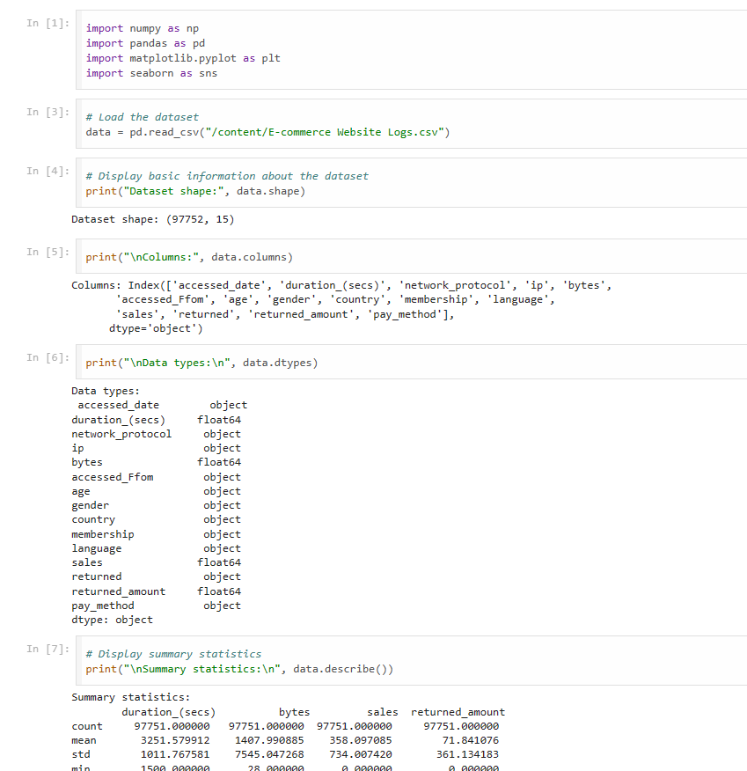
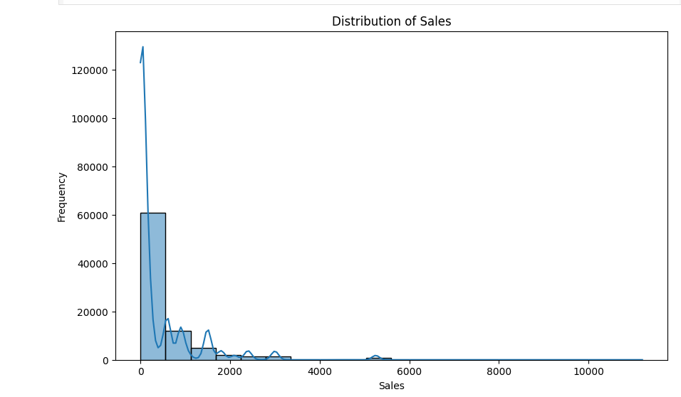
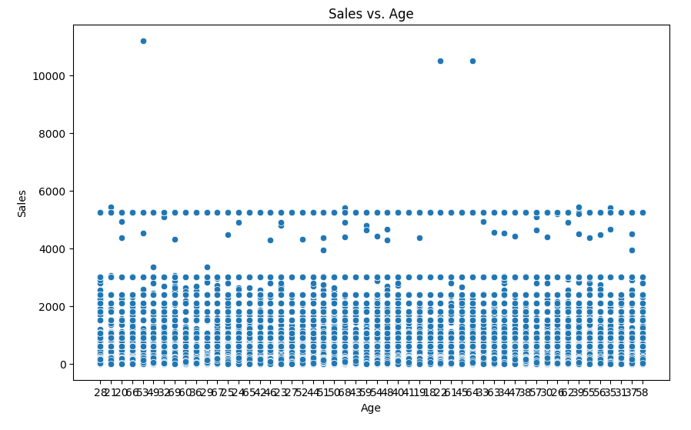
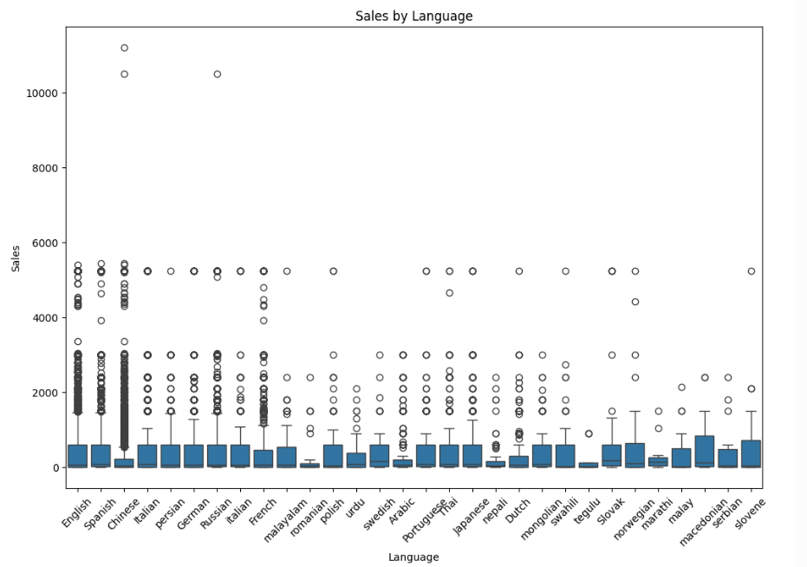
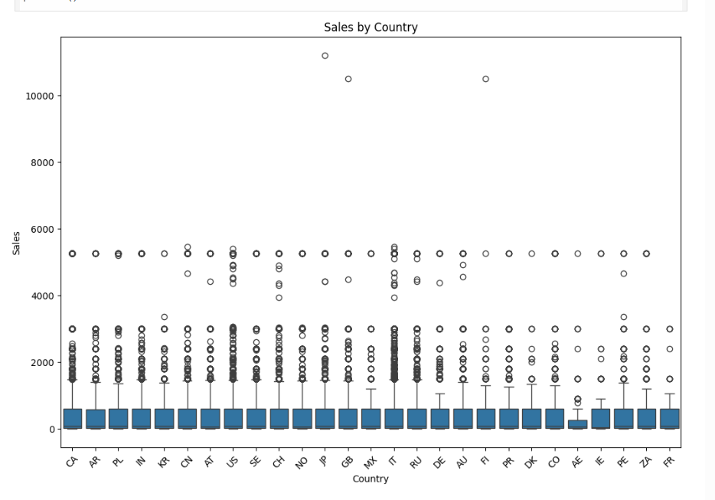
Result

Slide 10
Conclusion
The analysis aims to help data analysts practice exploratory data analysis (EDA) and visualization using a dataset of access timestamps, IP addresses, countries, languages, and sales figures. This dataset offers insights into website traffic and sales, revealing patterns in access times, locations, and language preferences. By correlating sales with IP addresses, targeted marketing strategies can be optimized. The analysis enhances understanding of user behavior, enabling data-driven decisions to improve engagement and sales. Future work involves integrating advanced analytics and machine learning for predictive insights and regularly updating the dataset for ongoing analysis.

Slide 11
Future scope
1. Advanced Analytics:
Implement machine learning models to predict user behavior.
Analyze conversion rates and customer journey mapping.
2. Real-Time Analysis:
Develop real-time data processing pipelines.
Provide immediate insights for dynamic decision-making.
3. Enhanced Personalization:
Use data to create personalized marketing strategies.
Tailor recommendations based on user behavior and preferences.
4. Integration with BI Tools:
Integrate with Business Intelligence (BI) tools for better reporting.
Utilize dashboards for comprehensive insights.
5. Security Enhancements:
Implement advanced security measures to protect data integrity.
Ensure compliance with data protection regulations.

Slide 12
References
IBM Watson Assistant tutorial
List of references and sources used in the development of the analysis and presentation
Add scholarly publications, papers, and web resources.

Slide 13
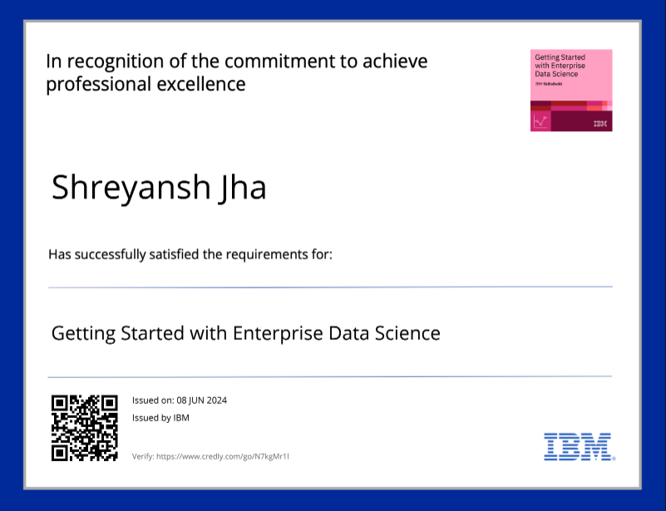
course certificate 1

Slide 14
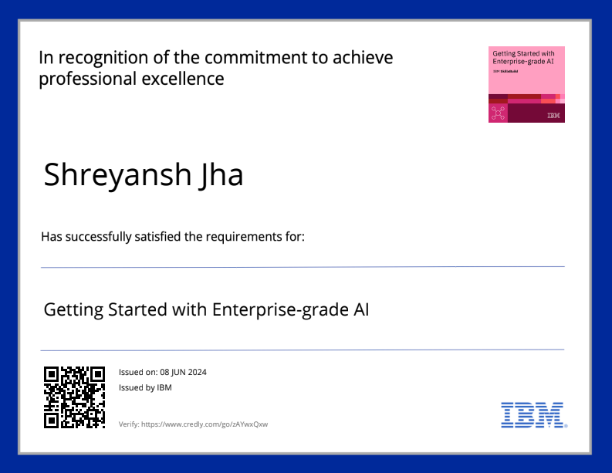
course certificate 2

Slide 15
THANK YOU

